Slide 1
DATA STRUCTURES – CST 201 MODULE 2

Slide 2
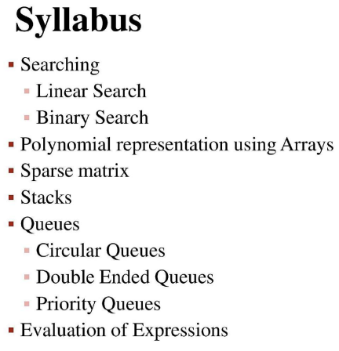

Slide 3
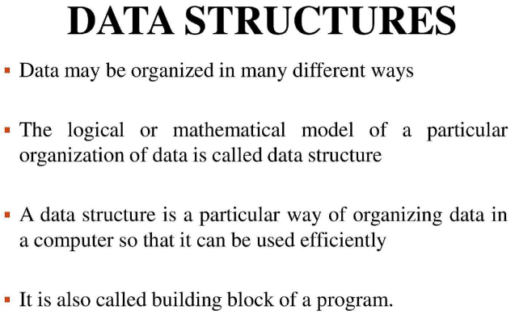

Slide 4
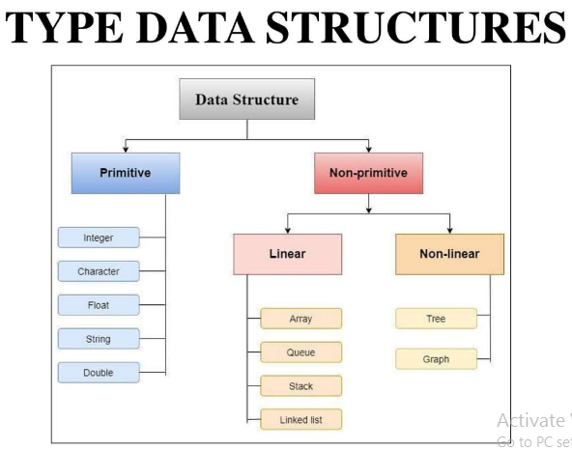

Slide 5
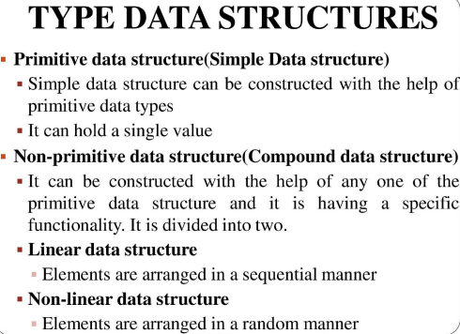

Slide 6
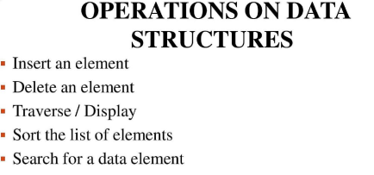

Slide 7
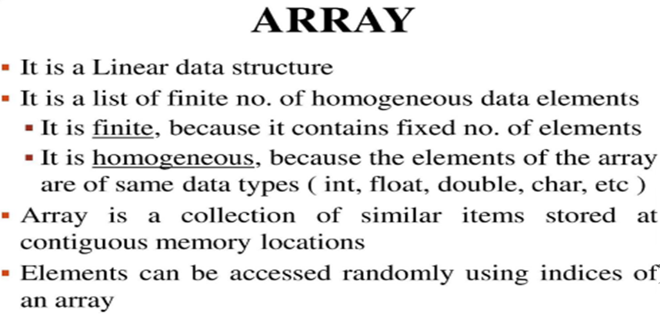
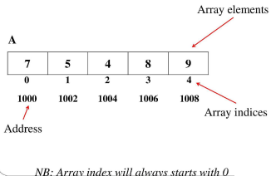

Slide 8
Operations on Array
Traversal
Insertion by location
Deletion of an element
Searching
Sorting
Merging

Slide 9

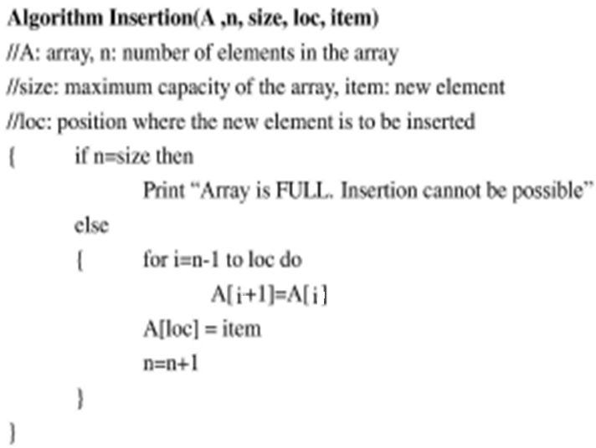

Slide 10
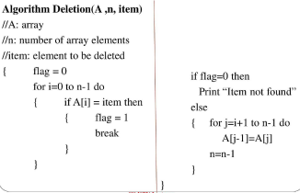

Slide 11
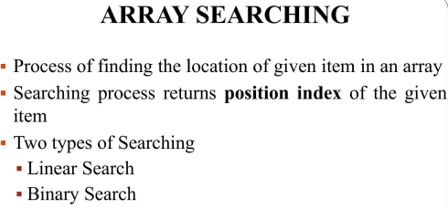

Slide 12
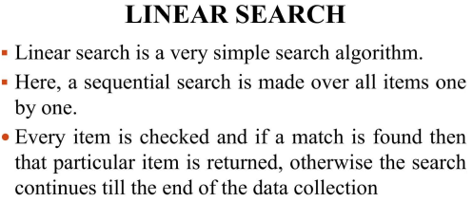
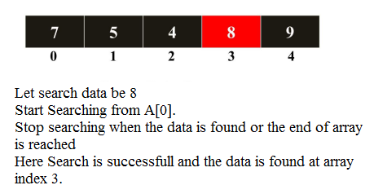

Slide 13
Algorithm LinearSearch(A,n,search_data)
Input: Array A, size n, data to be searched
Output: Index of array for successful search.
Initialise flag as 0.
For i=0 to n-1 do
2.1 if A[i]=search_data then
2.1.1 Assign flag as 1
2.1.2 Break
If flag=0 then
3.1 Print search data is not found
Else
4.1 Print Search data is found at Index i

Slide 14
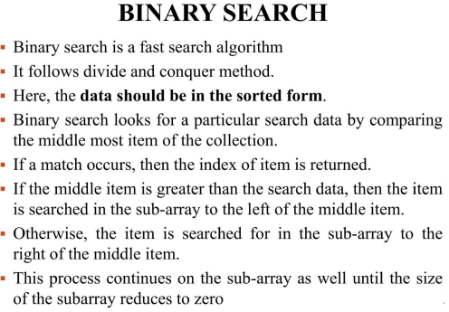

Slide 15
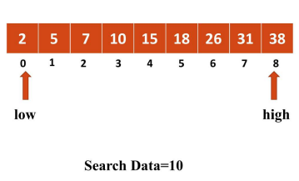
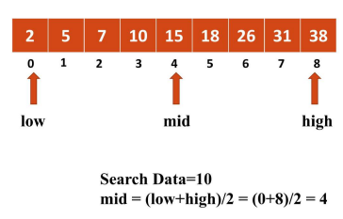
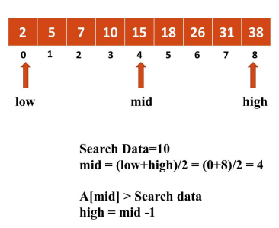
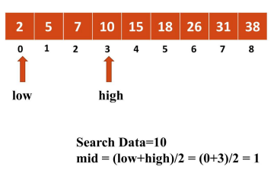

Slide 16
Algorithm BinarySearch(A,low,high,search_data)
Input: Array A, size n, data to be searched
Output: Index of array for successful search.
Initialise flag as 0.
While low <= high do
2.1 mid=(low+high)/2
2.2 if search_data = A[mid] then
2.2.1 Assign flag as 1
2.2.2 Break
2.3 else if search_data < A[mid] then
2.3.1 high=mid-1
2.4 else
2.4.1 low=mid+1
3. If flag=0 then
3.1 Print search data is not found
4. Else
4.1 Print Search data is found at Index mid

Slide 17
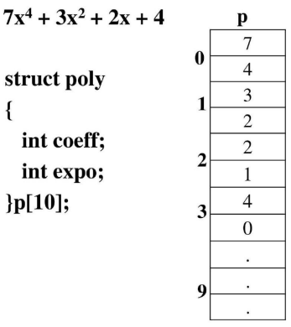
Polynomial Representation using Array

Slide 18
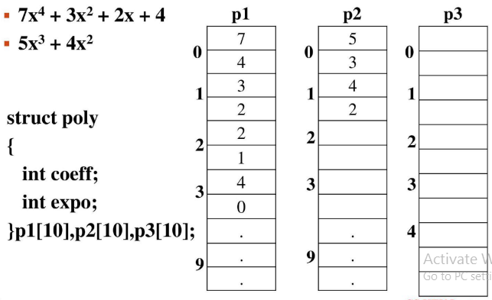
Polynomial Addition using Array

Slide 19
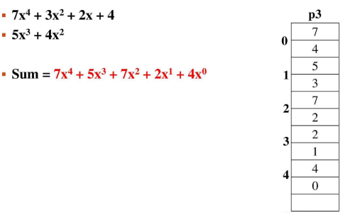

Slide 20
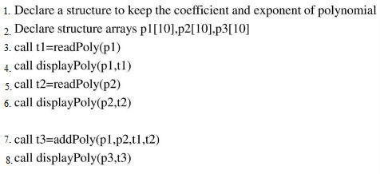
Polynomial Addition Algorithm
Algorithm main()

Slide 21
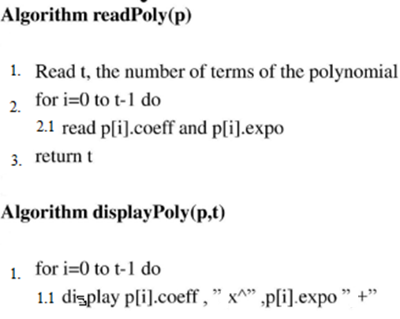

Slide 22
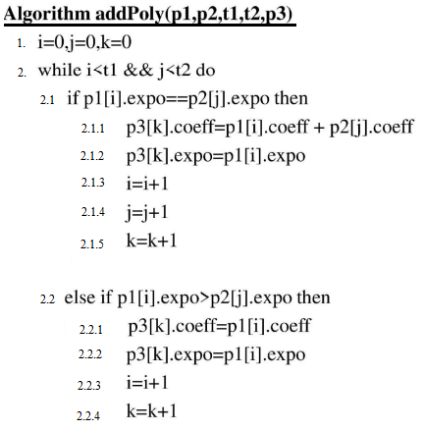

Slide 23
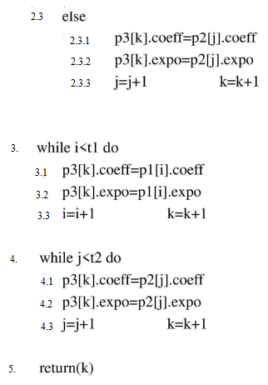

Slide 24
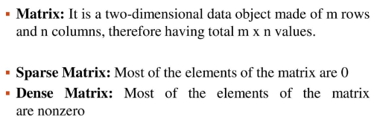
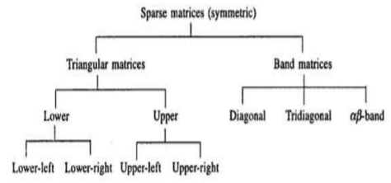
Sparse Matrix

Slide 25
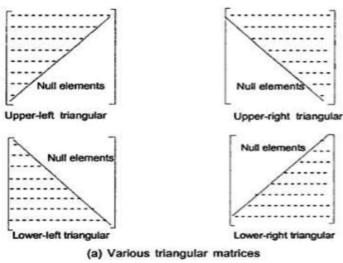

Slide 26
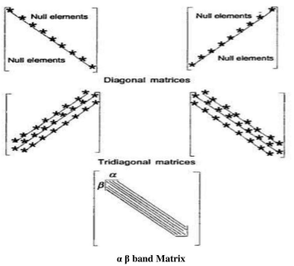

Slide 27
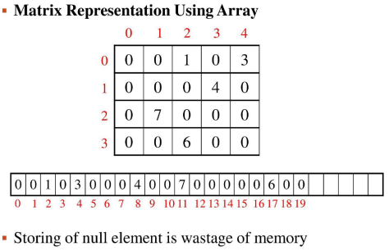

Slide 28
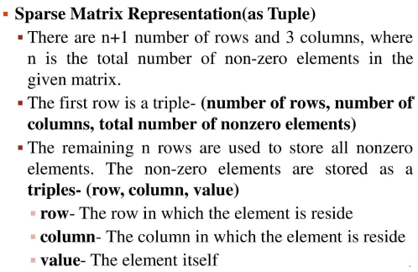
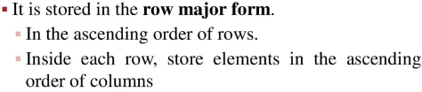

Slide 29
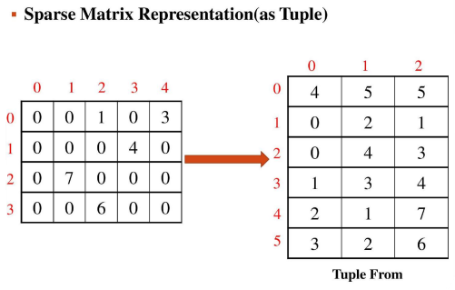

Slide 30
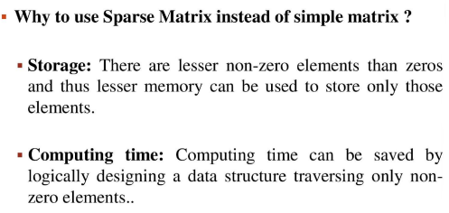

Slide 31
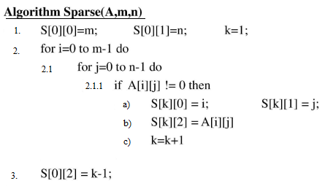
Sparse Matrix Representation as Tuple

Slide 32
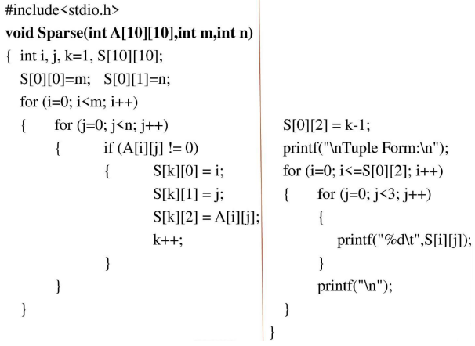
Program

Slide 33
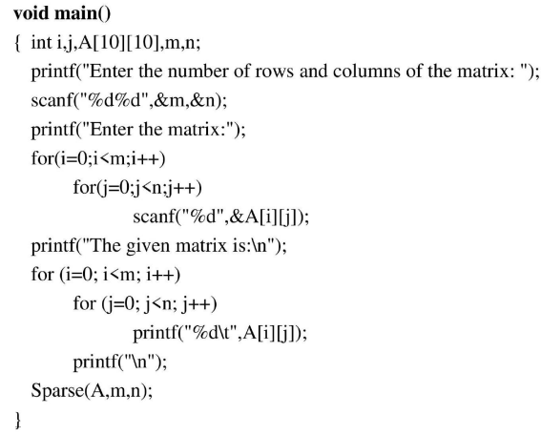

Slide 34
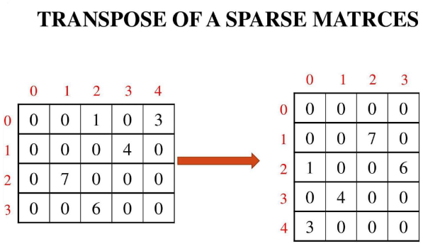

Slide 35
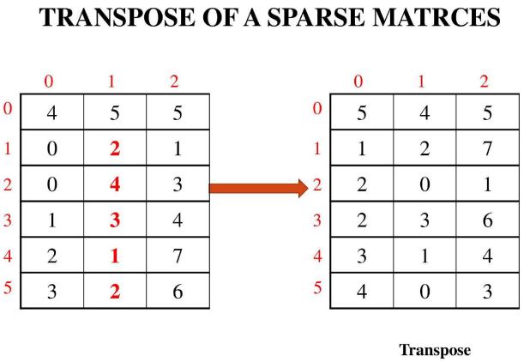

Slide 36
Algorithm SparseTranspose(S,T)
T[0][0]=S[0][1], T[0][1]=S[0][0], T[0][2]=S[0][2]
k=1, m=S[0][1], n=S[0][2]
For i=0 to m-1 do
3.1 for j=1 to n do
3.1.1 if S[j][1]=i then
a) T[k][0]=S[j][1]
b) T[k][1]=S[j][0]
c) T[k][2]=S[j][2]
d) k=k+1

Slide 37
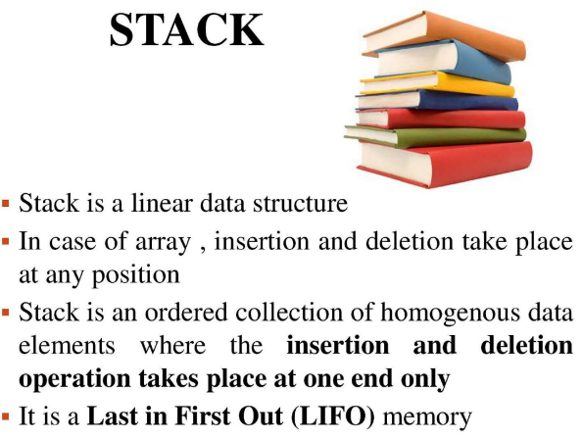

Slide 38
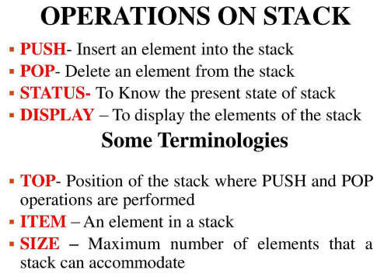
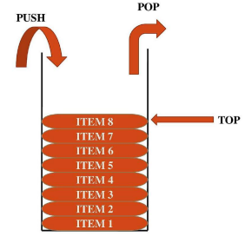

Slide 39
Real Time Examples of Stack:
Trains in a railway yard
Shipment of cargo
Applications of Stack:
Evaluation of Arithmetic Expressions
Implementation of Recursion
Representation of Stack in Memory
Array Representation
Linked List Representation

Slide 40
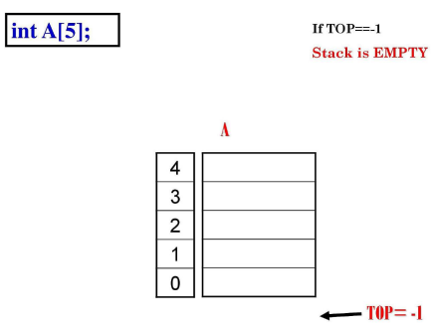
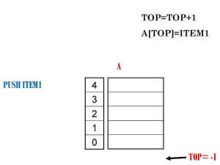
Array Representation of Stack

Slide 41
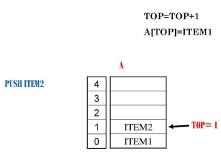
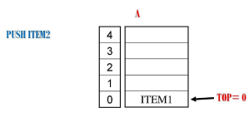

Slide 42
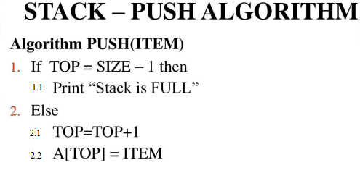

Slide 43
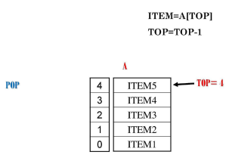
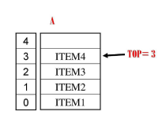

Slide 44
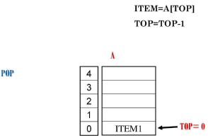
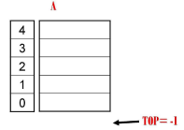

Slide 45


Slide 46


Slide 47


Slide 48


Slide 49


Slide 50


Slide 51


Slide 52


Slide 53




Slide 54


Slide 55



Slide 56


Slide 57


Slide 58


Slide 59


Slide 60


Slide 61



Slide 62


Slide 63


Slide 64


Slide 65


Slide 66


Slide 67


Slide 68


Slide 69


Slide 70



Slide 71



Slide 72



Slide 73


Slide 74


Slide 75


Slide 76


Slide 77



Slide 78



Slide 79



Slide 80


Slide 81


Slide 82


Slide 83


Slide 84


Slide 85


Slide 86


Slide 87


Slide 88


Slide 89


Slide 90


Slide 91


Slide 92



Slide 93


Slide 94


Slide 95


Slide 96


Slide 97


Slide 98


Slide 99


Slide 100


Slide 101


Slide 102


Slide 103


Slide 104


Slide 105




Slide 106




Slide 107


Slide 108


Slide 109

Eg: Infix to Postfix Conversion using stack

Slide 110


Slide 111


Slide 112


Slide 113

Eg: Infix to Prefix Conversion (for steps refer your class note)

Slide 114


Slide 115

Eg: Prefix Evaluation (For steps refer your class note)

Slide 116
University Questions
Part A ( Each Question carries 3 marks)
1. Write an algorithm to insert a new element in a particular position of an array.
2. Represent the polynomial P(X,Y) = 10X7Y 7+5X6Y 5+4X4Y 2+8X2+25 using array of structures.
3. Given a matrix having 10 rows and 10 columns and 12 nonzero elements. How much space can be saved by representing the matrix in sparse (tuple) form?
4. Write any three applications of Stack.
5. Explain PUSH and POP operations in stack.
6. Convert the expression A + B * C – D / E * H to postfix form. Show each step in the conversion including the stack contents
7. Find the postfix expressions of the following infix expression
a) (A+B)*K+D/(E+F*G)+H b) ((A/D+B)*(K^Y))
8. Convert the expression ((A/(B-D+E))*(F-G)*H) to postfix form. Show each step in the conversion including the stack contents

Slide 117
PART B
1. a. Write the binary search algorithms and demonstrate it with an example. (8 marks)
b. Explain the data Structure Stack in detail. Display the status of a stack with maximum capacity 5.on the following operations (in order ) on it. Pop( ), Push(5), push(4), Pop( ), Push(9) (6 marks)
2. a. Write the algorithm to evaluate Postfix expression and show each steps in the evaluation of the expression: 2 3 + 8 – 5 * (8 marks)
b. What do you mean by circular queue? Write algorithms to insert and delete elements on circular queue. (6 marks)
3. a. Discuss an algorithm to convert an infix expression to a postfix expression (8 marks)
b. Write an algorithm to find the transpose of a matrix represented in tuple form (6 marks)

Slide 118
4. a. Write algorithms to insert and delete elements from a circular Queue (6 marks)
b. Write an algorithm to add two polynomials represented using arrays (8 marks)
5. a. What is sparse matrix? Write an algorithm to add two sparse matrices. (10 marks)
b. Write an algorithm to insert an element to a circular queue using array. (4 marks)
6. a. Convert P*(Q+R)/S to postfix notation. Write algorithm and step-by-step conversion using the stack. (10 marks)
b. Write an algorithm to search an element using binary search. Discuss its time complexity. (4 marks)
7. a. Write algorithms to insert and delete elements from a double ended queue. Demonstrate with examples (10 marks)
b. Compare and contrast Circular Queue with a Normal Queue (4 marks)
8. a. Write an algorithm to insert and delete elements from a Priority Queue (8 marks) b. Discuss an algorithm to convert an infix expression to a prefix expression (6 marks)

